Slide 1
T4
Text
Template
Transformation
ToolKit
Odessa Technologies Inc.

Slide 2
What Is T4?
T4 = Text
Template
Transformation
ToolKit
Code Generation Engine
Built By Microsoft
Included in VS2008 onwards

Slide 3
What Is T4? (Contd..)
Generates any textual format
Common Examples
Code (C#, VB, etc..)
SQL
XML
Template Based
Similar syntax to ASP
Very Extensible

Slide 4
What Is T4? (Contd..)
But editing T4 sucks..
With default VS..
No Syntax Highlighting
No Intellisense
Looks like Notepad…
3rd party T4 tools also can be used like CodeSmith, Apache Velocity etc..

Slide 5
“If you are going to do something twice or more, manually, in your company, Generate It.”
                ~ Scott Hanselman

Slide 6
T4 can be used to Generate …
Code Templates
(MVC Add Views)
Database to Code
Code to Database
Configuration
Files
Domain –Specific Languages
(DSL Toolkit)
Removing Magic
Strings
(T4 MVC)
Add Logic to CSS
(T4 CSS)

Slide 7
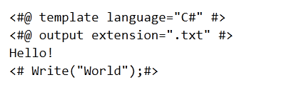
Sample Template

Slide 8

Template Syntax
Processing Directives
Processing directives provide template compilation and processing options.
In the example above, <#@ template #> directive specifies that code blocks of this template are written in C#.
To know more about all the types of processing directives please refer the below link.
http://www.olegsych.com/2007/12/text-template-transformation-toolkit/

Slide 9
Template Syntax
Text Blocks
Text blocks are copied to the output “as is”. In the example above, Hello is a text block.

Slide 10
Template Syntax
Code Blocks
Code blocks contain Visual Basic or C# code that can manipulate text blocks or generate template output directly.
In the example above, the code block calls Write method which writes “World!” to the output file.

Slide 11
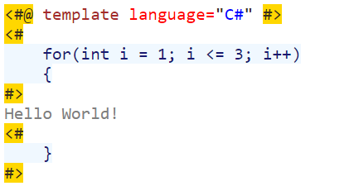
Template Syntax
Statement Blocks
You can use statement blocks in text templates to control the flow of processing in the text template.
Statement blocks enable you either to structure templates to output things conditionally or to iterate over data to output things repeatedly for each item in that data.
Code statements are delineated using opening (<#) and closing (#>) text template tags. The general syntax is: <# StatementCode #>

Slide 12
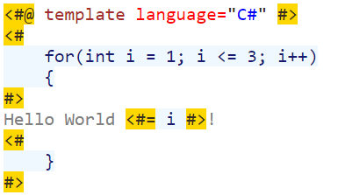
Template Syntax
Expression Blocks
You can use expression blocks in text templates to add strings to the generated text output.
In text templates, expression blocks are delineated by using opening (<#=) and closing (#>) text template tags. The general syntax is: <#= ExpressionCode #>

Slide 13
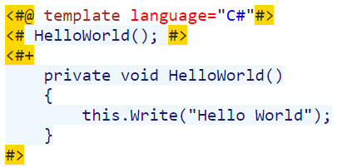
Template Syntax
Class Feature Blocks
You can use the class feature blocks in your text templates to add helper functions. Helper functions enable you to avoid repeating common code.
The general syntax is: <#+ FeatureCode #>

Slide 14
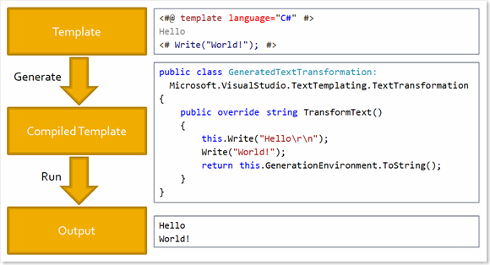
How It Works

Slide 15
DEMO
Text Block
Code Block
Statement Block
Expression Block
Class feature Block
Class
XAML

Slide 16

Ask your questions in our Q&A forum – http://192.168.10.75.question2answers

